Slide 1
Inference in first-order logic

Slide 2
Outline
Forward chaining
Backward chaining
Resolution

Slide 3
Reduction to propositional inference
Suppose the KB contains just the following:
  ∀x King(x) ∧ Greedy(x) ⇒ Evil(x)
  King(John)
  Greedy(John)
  Brother(Richard,John)
Instantiating the universal sentence in all possible ways, we have:
  King(John) ∧ Greedy(John) ⇒ Evil(John)
  King(Richard) ∧ Greedy(Richard) ⇒ Evil(Richard)
  King(John)
  Greedy(John)
  Brother(Richard,John)
The new KB is propositionalized: proposition symbols are
  King(John), Greedy(John), Evil(John), King(Richard), etc.

Slide 4
Example knowledge base
The law says that it is a crime for an American to sell weapons to hostile nations. The country Nono, an enemy of America, has some missiles, and all of its missiles were sold to it by Colonel West, who is American.
Prove that Col. West is a criminal

Slide 5
Example knowledge base
... it is a crime for an American to sell weapons to hostile nations:
  American(x) ∧ Weapon(y) ∧ Sells(x,y,z) ∧ Hostile(z) ⇒ Criminal(x)
Nono … has some missiles, i.e., ∃x Owns(Nono,x) ∧ Missile(x): convert to two definite clauses
  Owns(Nono,M₁) and Missile(M₁)
… all of its missiles were sold to it by Colonel West
  Missile(x) ∧ Owns(Nono,x) ⇒ Sells(West,x,Nono)
Missiles are weapons:
  Missile(x) ⇒ Weapon(x)
An enemy of America counts as "hostile“:
  Enemy(x,America) ⇒ Hostile(x)
West, who is American …
  American(West)
The country Nono, an enemy of America …
  Enemy(Nono,America)

Slide 6
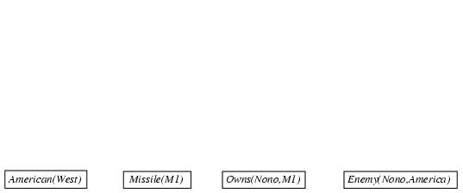
Forward chaining proof

Slide 7
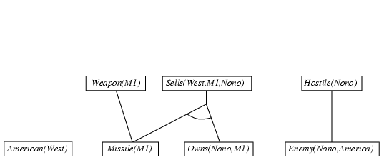
Forward chaining proof

Slide 8
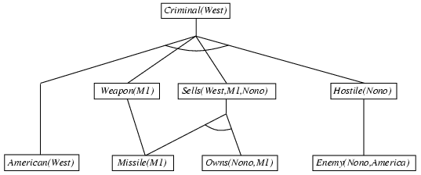
Forward chaining proof

Slide 9
Properties of forward chaining
Sound and complete for first-order definite clauses
Datalog = first-order definite clauses + no functions
FC terminates for Datalog in finite number of iterations
May not terminate in general if α is not entailed
This is unavoidable: entailment with definite clauses is semi-decidable

Slide 10
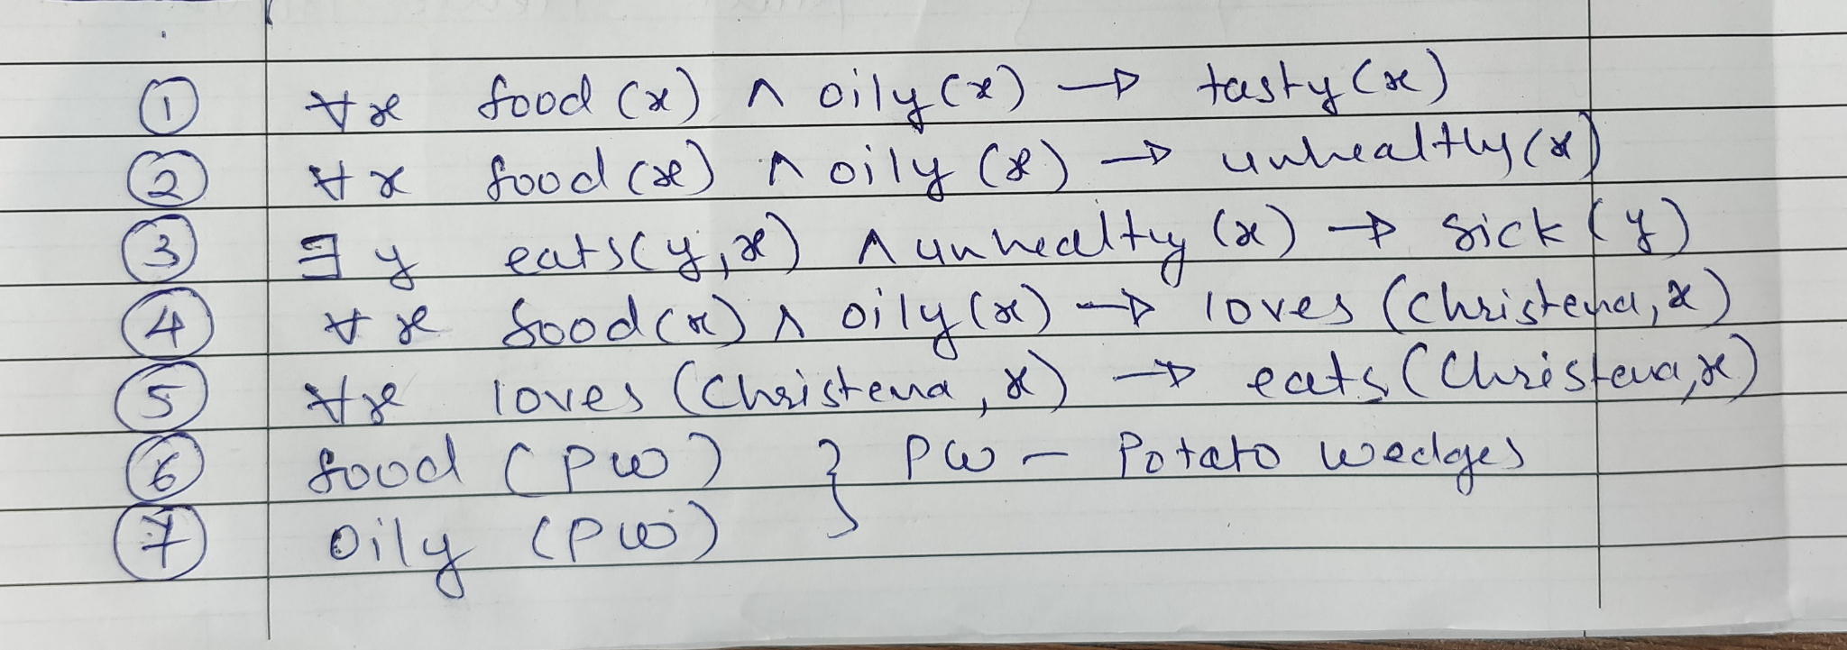
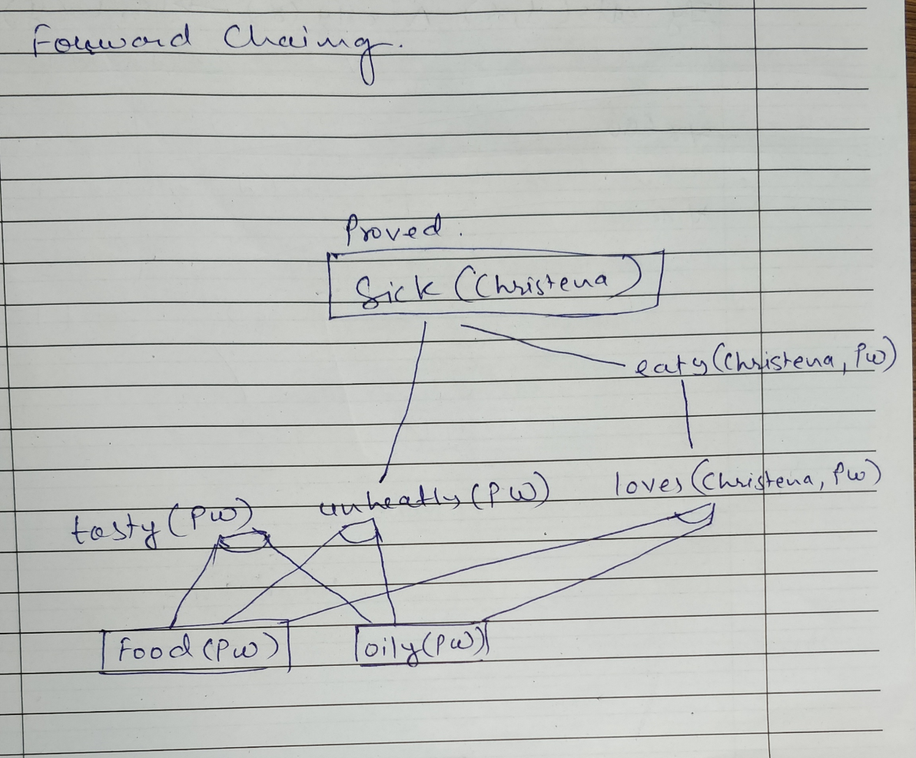
Explain Forward chaining in detail. Examine how it is different from Backward chaining?
Using the forward chaining method to find if Christena is healthy or sick. Following is the given information:
If food is oily it is good in taste and not good for health. If anyone eats unhealthy food they fall sick. Christena loves oily food and she eats only what she loves. “Potato wedges” is an oily food item.

Slide 11
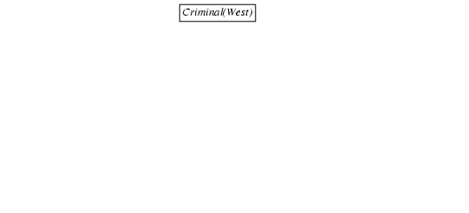
Backward chaining example

Slide 12
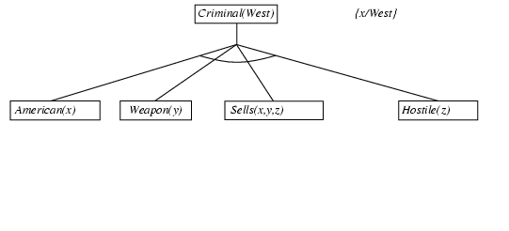
Backward chaining example

Slide 13
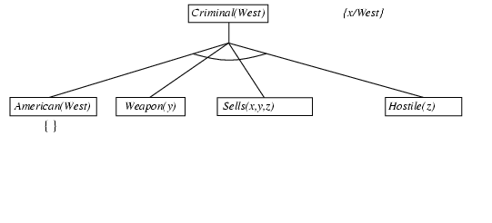
Backward chaining example

Slide 14
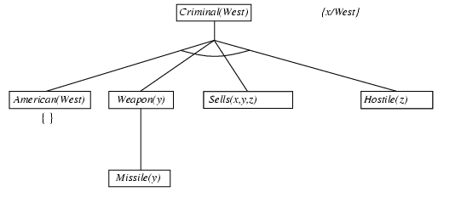
Backward chaining example

Slide 15
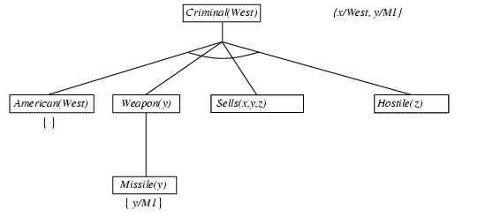
Backward chaining example

Slide 16
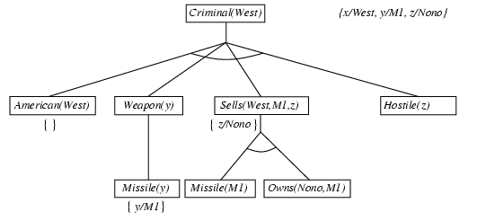
Backward chaining example

Slide 17
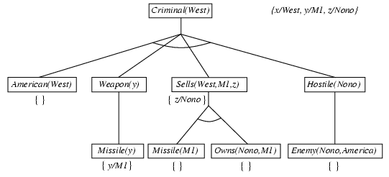
Backward chaining example

Slide 18
Backward chaining example

Slide 19
Properties of backward chaining
Depth-first recursive proof search: space is linear in size of proof
Incomplete due to infinite loops
  ⇒ fix by checking current goal against every goal on stack
Inefficient due to repeated sub goals (both success and failure)
  ⇒ fix using caching of previous results (extra space)
Widely used for logic programming

Slide 20
: brief summary
Full first-order version:
The two clauses are assumed to be standardized apart so that they share no variables.
For example,
¬Rich(x) ∨ Unhappy(x)
Rich(Ken) ∨ Unhappy(Ken)
with θ = {x/Ken}
Apply resolution steps to CNF(KB ∧ ¬α); complete for FOL

Slide 21
Resolution - Conversion to CNF
Everyone who loves all animals is loved by someone:
  ∀x [∀y Animal(y) ⇒ Loves(x,y)] ⇒ [∃y Loves(y,x)]
1. Eliminate biconditionals and implications
  ∀x [¬∀y ¬Animal(y) ∨ Loves(x,y)] ∨ [∃y Loves(y,x)]
2. Move ¬ inwards: ¬∀x p ≡ ∃x ¬p, ¬ ∃x p ≡ ∀x ¬p
  ∀x [∃y ¬(¬Animal(y) ∨ Loves(x,y))] ∨ [∃y Loves(y,x)]
  ∀x [∃y ¬¬Animal(y) ∧ ¬Loves(x,y)] ∨ [∃y Loves(y,x)]
  ∀x [∃y Animal(y) ∧ ¬Loves(x,y)] ∨ [∃y Loves(y,x)]

Slide 22
Conversion to CNF contd.
Standardize variables: each quantifier should use a different one
  ∀x [∃y Animal(y) ∧ ¬Loves(x,y)] ∨ [∃z Loves(z,x)]
Skolemize: a more general form of existential instantiation.
  Each existential variable is replaced by a Skolem function of the enclosing universally quantified variables:
  ∀x [Animal(F(x)) ∧ ¬Loves(x, F(x))] ∨ Loves(G(x),x)
Drop universal quantifiers:
  [Animal(F(x)) ∧ ¬Loves(x,F(x))] ∨ Loves(G(x),x)
Distribute ∨ over ∧ :
  [Animal(F(x)) ∨ Loves(G(x),x)] ∧ [¬Loves(x,F(x)) ∨ Loves(G(x),x)]

Slide 23
Example knowledge base
... it is a crime for an American to sell weapons to hostile nations:
  American(x) ∧ Weapon(y) ∧ Sells(x,y,z) ∧ Hostile(z) ⇒ Criminal(x)
Nono … has some missiles, i.e., ∃x Owns(Nono,x) ∧ Missile(x): convert to two definite clauses
  Owns(Nono,M₁) and Missile(M₁)
… all of its missiles were sold to it by Colonel West
  Missile(x) ∧ Owns(Nono,x) ⇒ Sells(West,x,Nono)
Missiles are weapons:
  Missile(x) ⇒ Weapon(x)
An enemy of America counts as "hostile“:
  Enemy(x,America) ⇒ Hostile(x)
West, who is American …
  American(West)
The country Nono, an enemy of America …
  Enemy(Nono,America)

Slide 24
Sentences in CNF
C1: ¬American(x) ∨ ¬Weapon(y) ∨ ¬Sells(x,y,z) ∨ ¬Hostile(z) ∨ Criminal(x)
C2: ¬Missile(x) ∨ ¬Owns(Nono,x) ∨ ¬Sells(West,x,Nono)
C3: ¬Enemy(x, America) ∨ ¬Hostile(x)
C4: ¬Missile(x) ∨ Weapon(x)
F1: Owns (Nono, M1)
F2: American(West)
F3: Missile(M1)
F4: Enemy(Nono, America)
Negated Goal: ¬ Criminal(West)

Slide 25
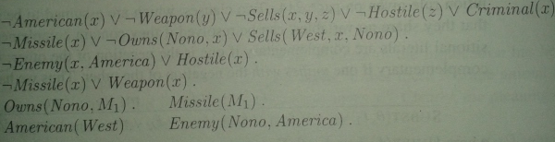
CNF

Slide 26
Example: Proof by Resolution
Negated Goal: ¬ Criminal(West)
C1: ¬American(x) ∨ ¬Weapon(y) ∨ ¬Sells(x, y, z) ∨ ¬Hostile(z) ∨ Criminal(x)
Resolution Principle
mgu: most general unifier
x / West
Conclusion
¬American(West) ∨ ¬Weapon(y) ∨ ¬Sells(West, y, z) ∨ ¬Hostile(z)

Slide 27
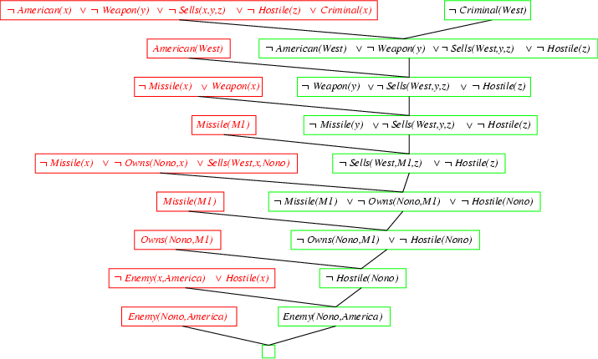
Resolution proof: definite clauses

Slide 28
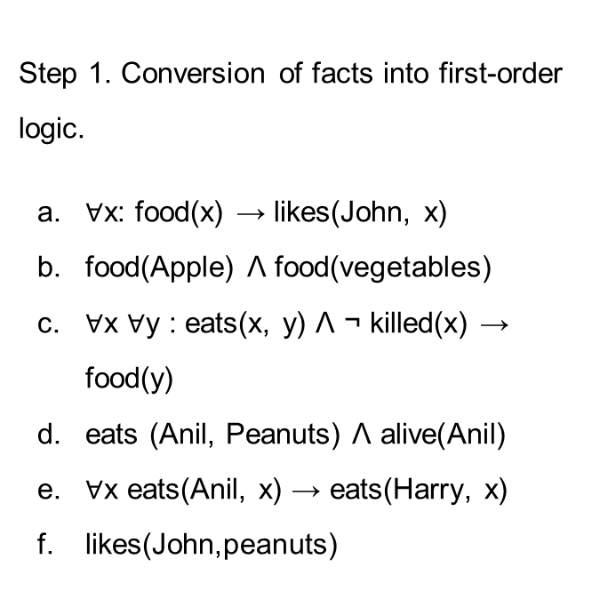
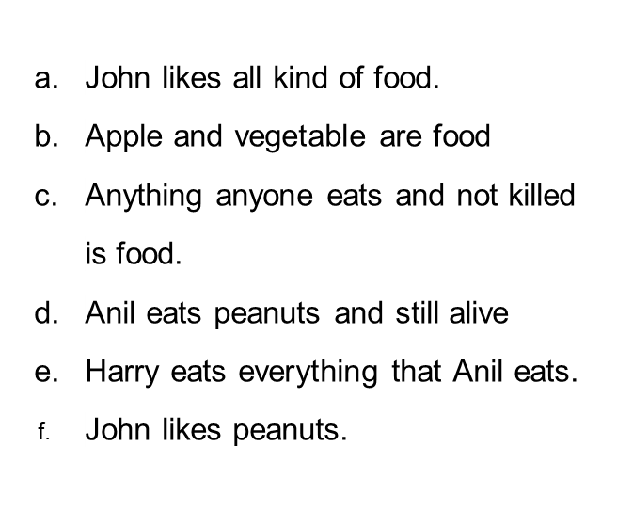
Example

Slide 29
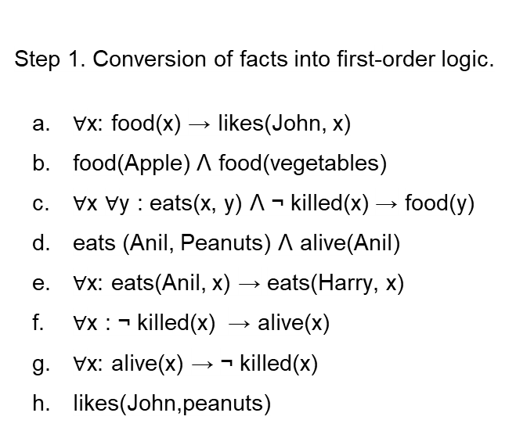
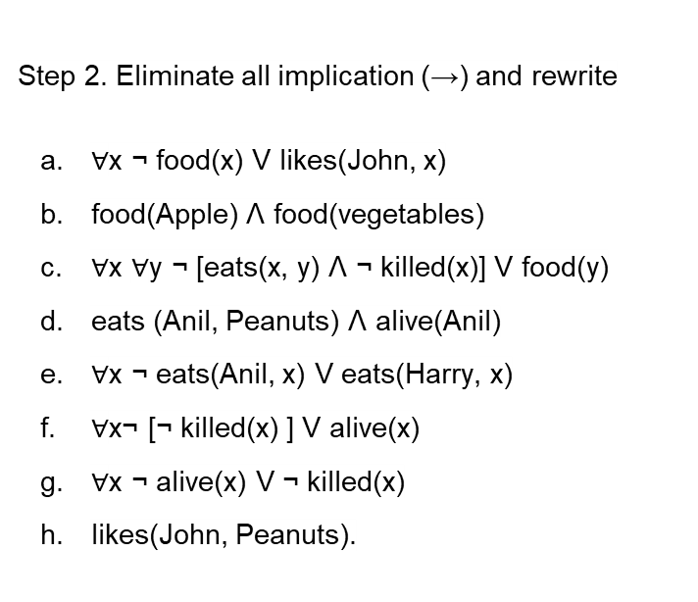
FOL to CNF Conversion

Slide 30
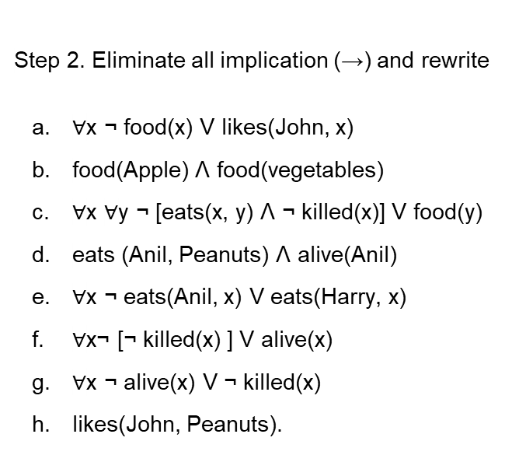
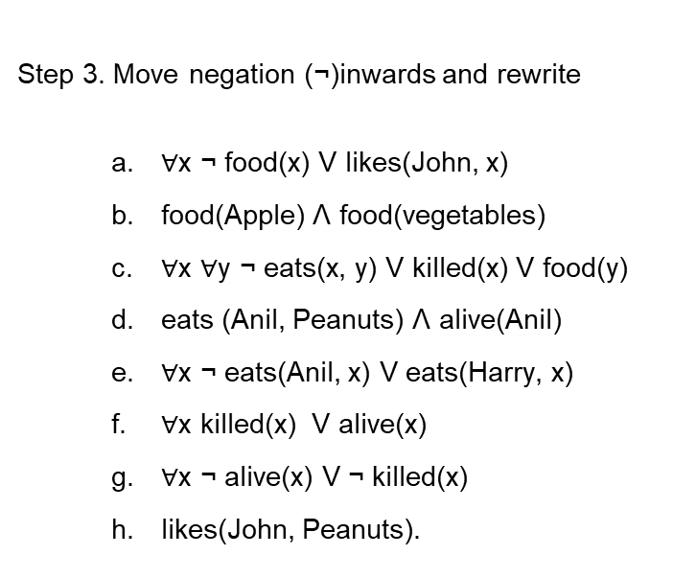
Move negation inwards

Slide 31
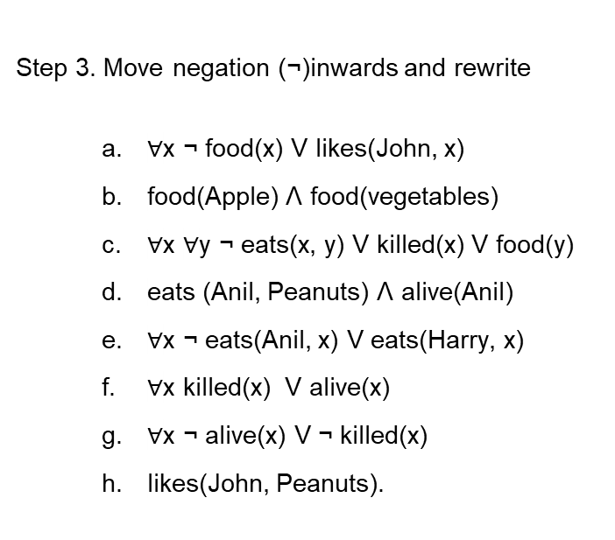
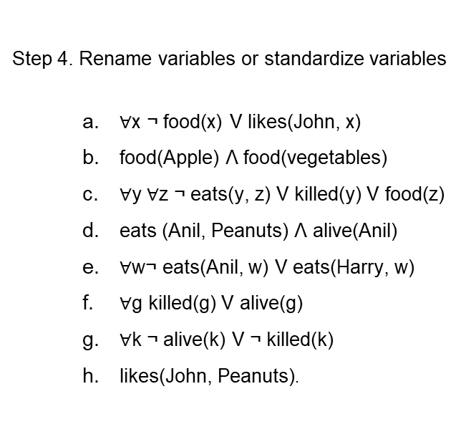
Rename/ standardize Variables

Slide 32
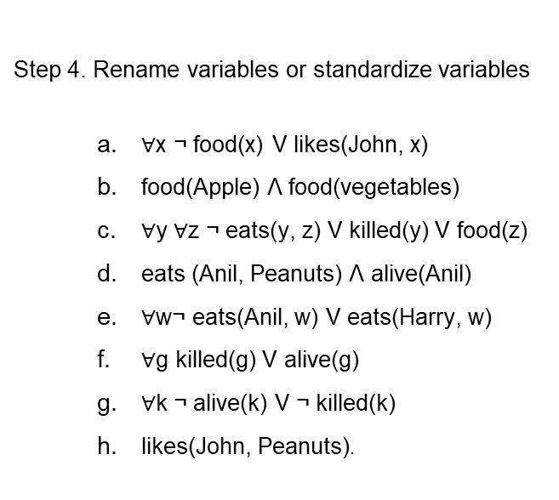
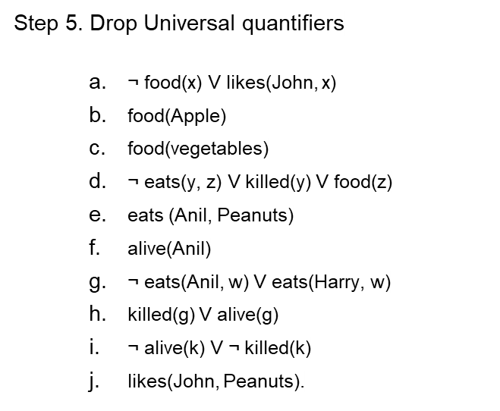
Drop Universal Quantifiers

Slide 33
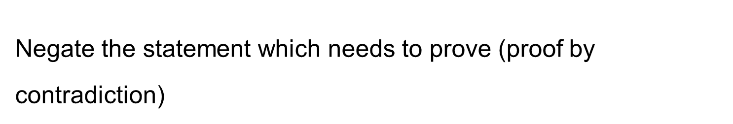
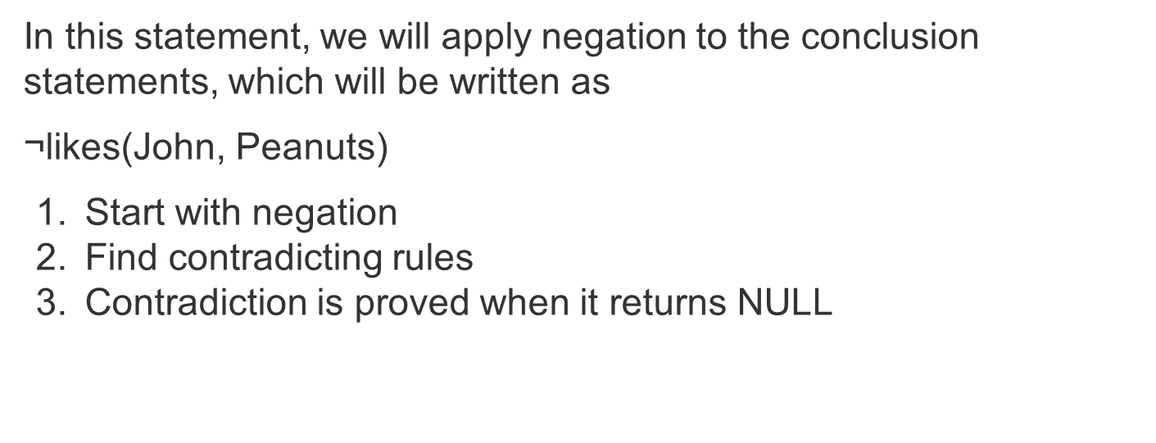

Slide 34
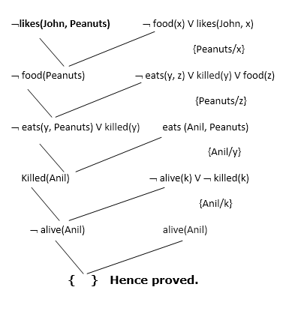
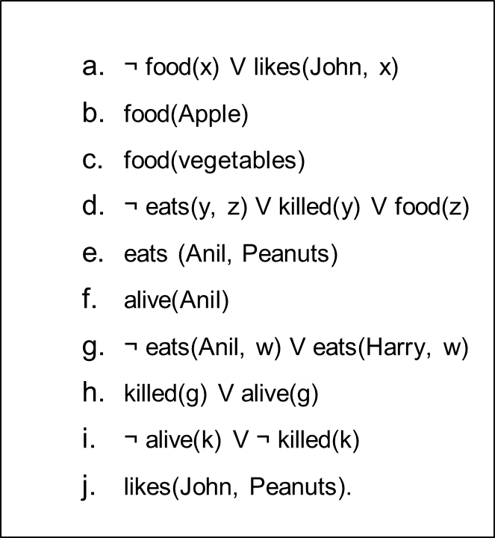

Slide 35
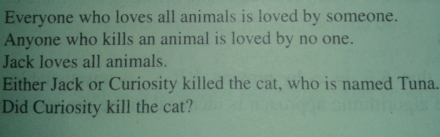
Resolution example

Slide 36
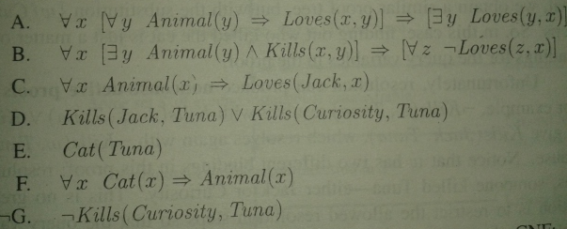
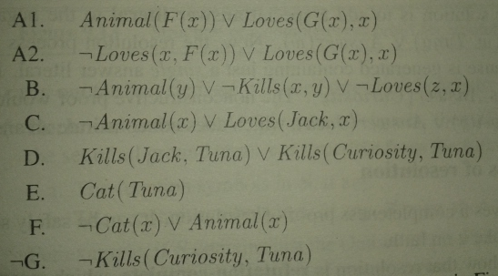
FOL
CNF

Slide 37
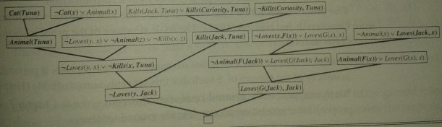
Resolution Proof (who kill the cat?)

